Slide 1
Electricity
For a fun experiment try putting a fork in an outlet (please do not for legal reason that was a joke)

Slide 2
Charges

Slide 3
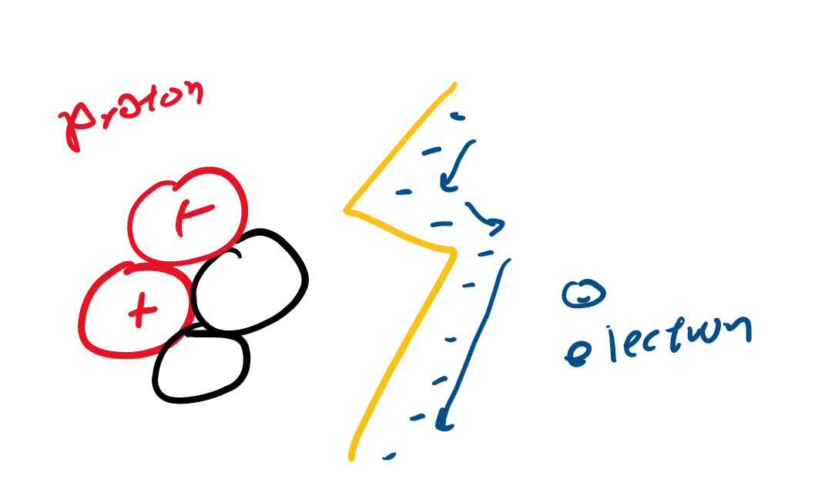
Protons/Electrons
Protons: positive charge
Electrons: negative charge
Charge is the “mass” in the electricity world
Electricity is a flow of electrons
Charge is labeled (q)

Slide 4
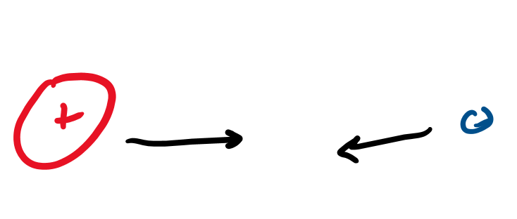
Opposites
Attract!

Slide 5
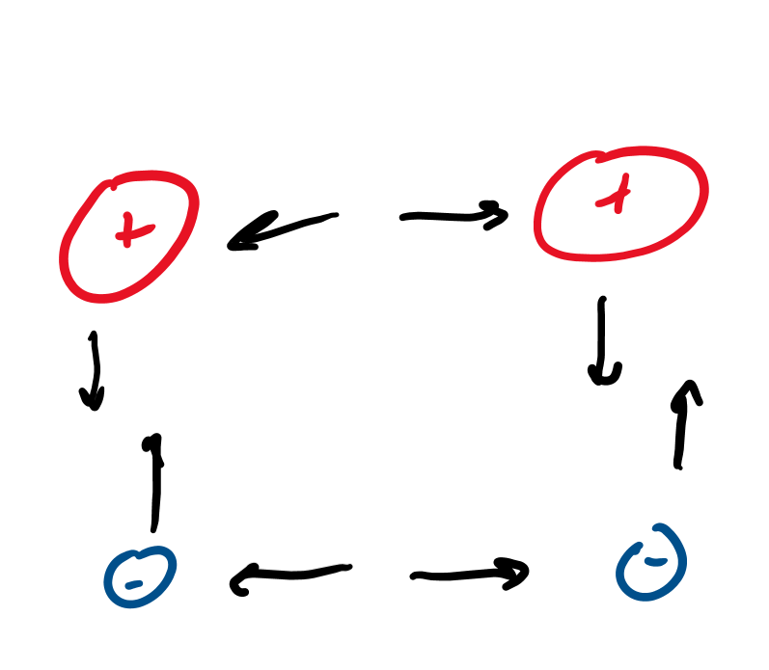
Similar charges
Repel each other!

Slide 6
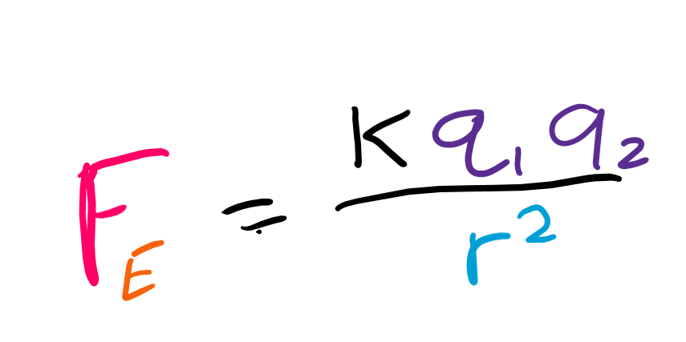
How much do they attract each other?
Based on the charges.
Larger charges mean more attraction.
Based on distance.
Larger distance means smaller/weaker attraction.
Then we uhh need a constant. . . (coulomb’s constant -- k)
F is force, q is charge, r is distance

Slide 7
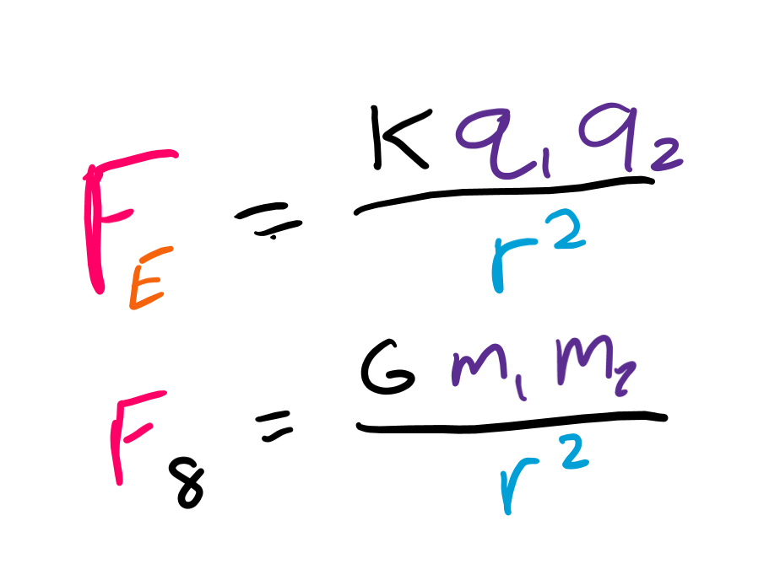
Comparisons
Look at the equations

Slide 8
Electric field

Slide 9
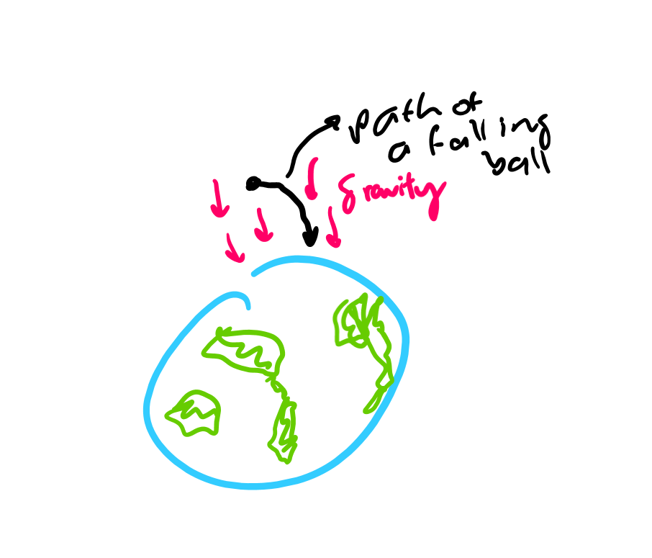
Gravitational acceleration?
F = ma
So we said the acceleration due to gravity (on earth) can be called g
And so F = mg for gravitational force on earth

Slide 10
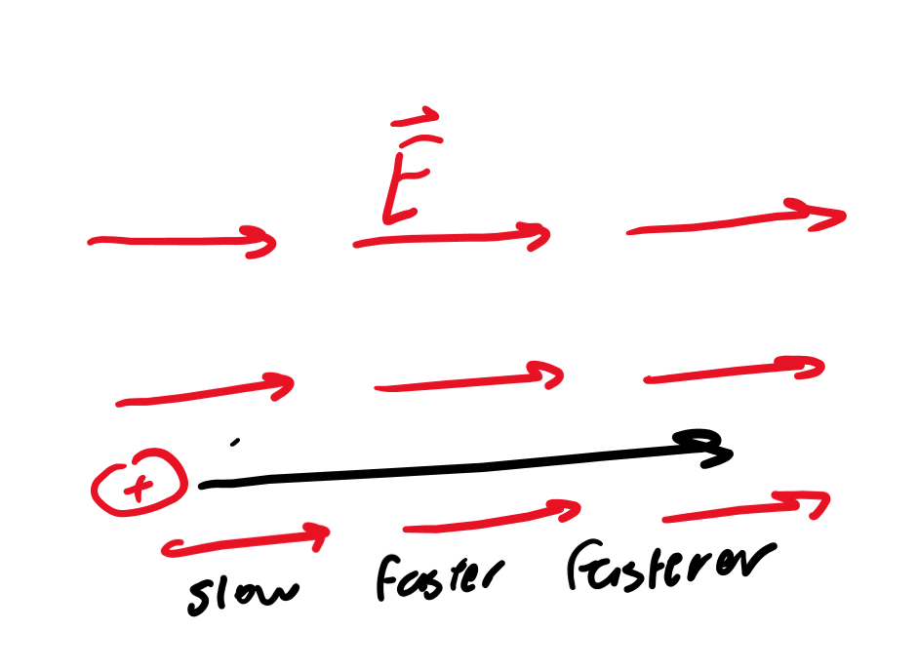
Electric “acceleration”
E stands for “electric field strength”
It’s how much a charge is “accelerated” by an electric force

Slide 11
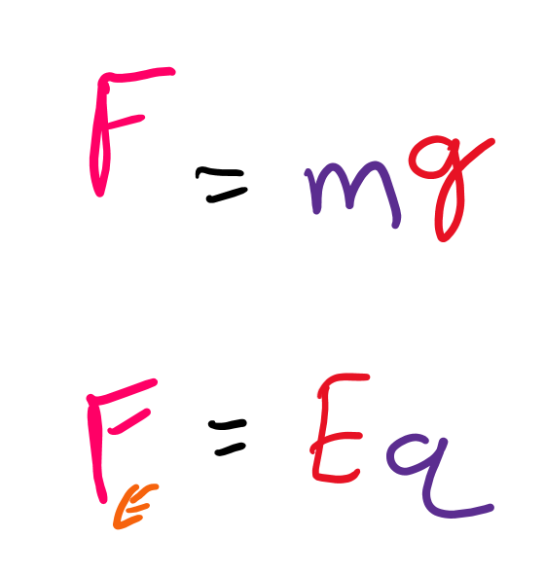
How to get electric force?
F = ma
F(electric) = Eq
You can use coulomb's law to find the electric field force

Slide 12
Electric potential

Slide 13
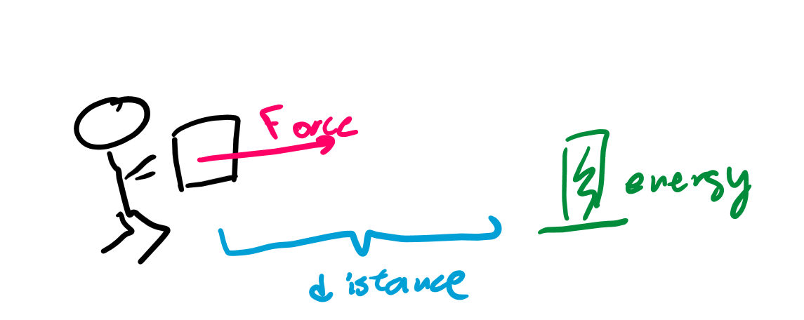
Work
If you use force you get tired, so you did work!
If you move a distance you get tired, so you did work!
Work is related to force and distance.
Doing work converts energy.

Slide 14
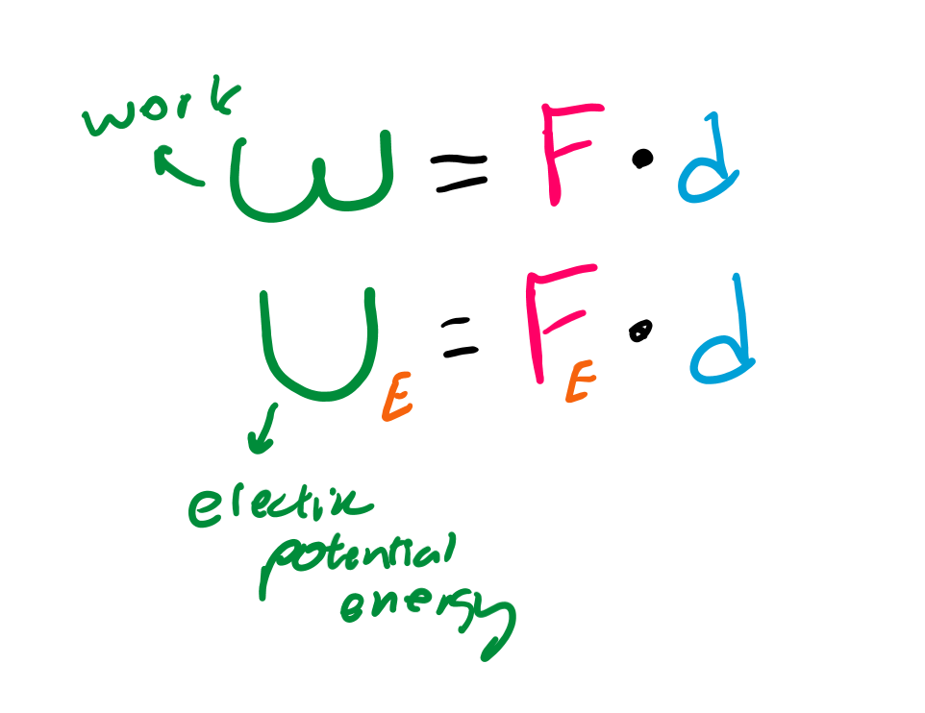
Work in electricity
Electric force times distance would be electric work!
Work takes energy.
The energy we make by doing work in electric fields is electric potential energy!

Slide 15
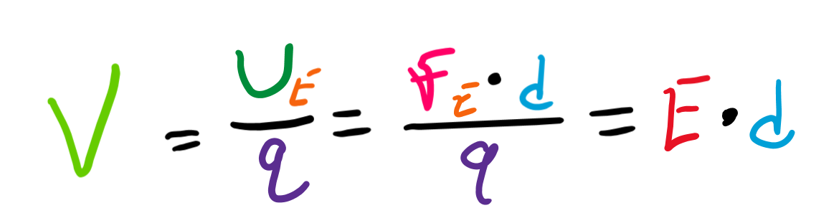
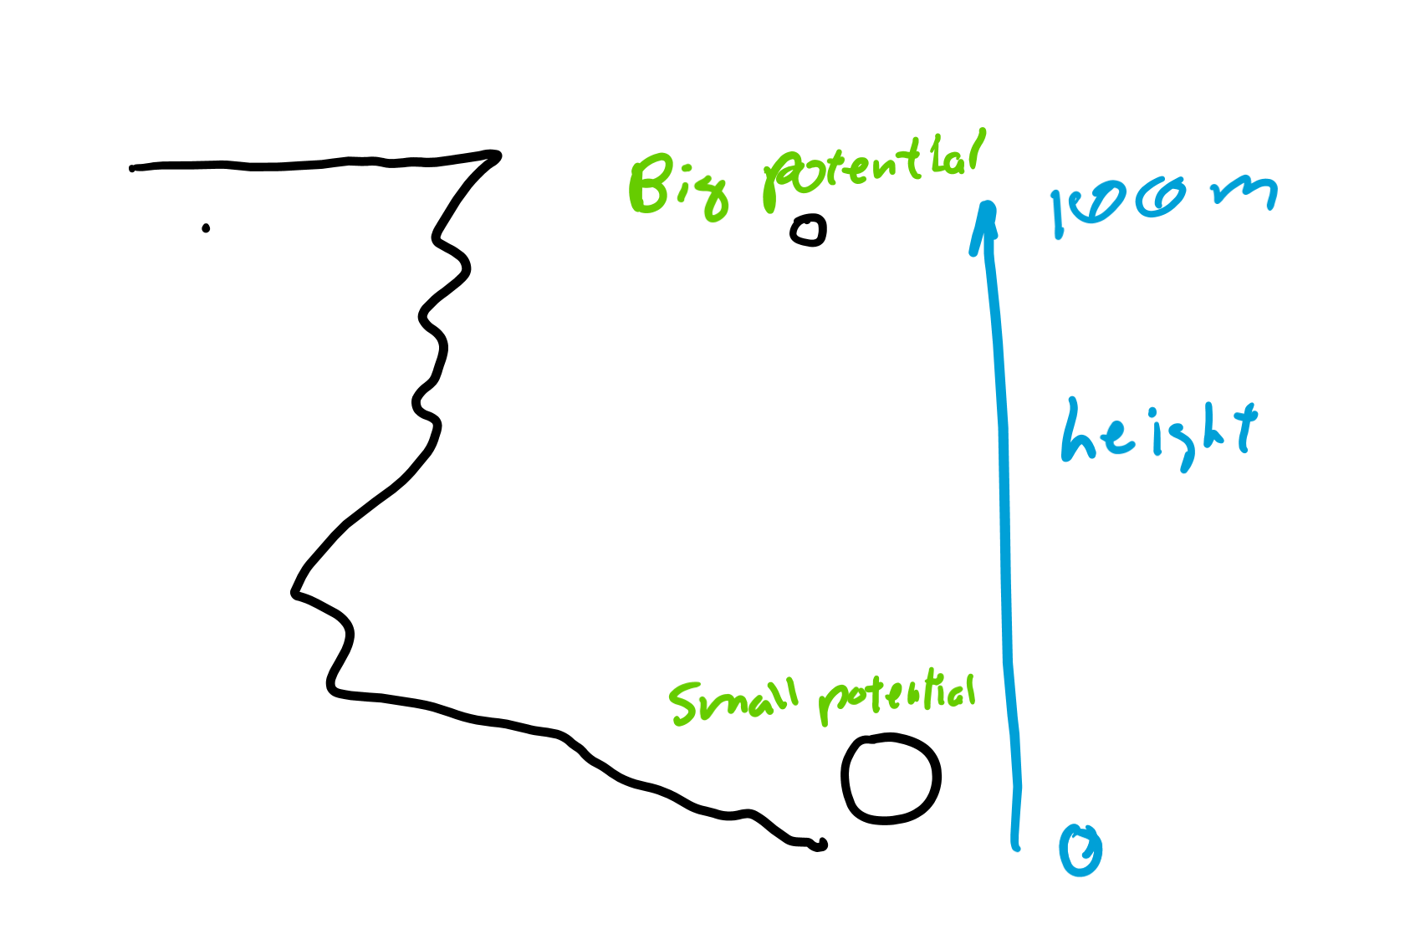
Electric potential (no energy)
Tells us how much potential energy a charge would have
Potential energy divided by charge gives the potential.

Slide 16
Particles in various fields

Slide 17
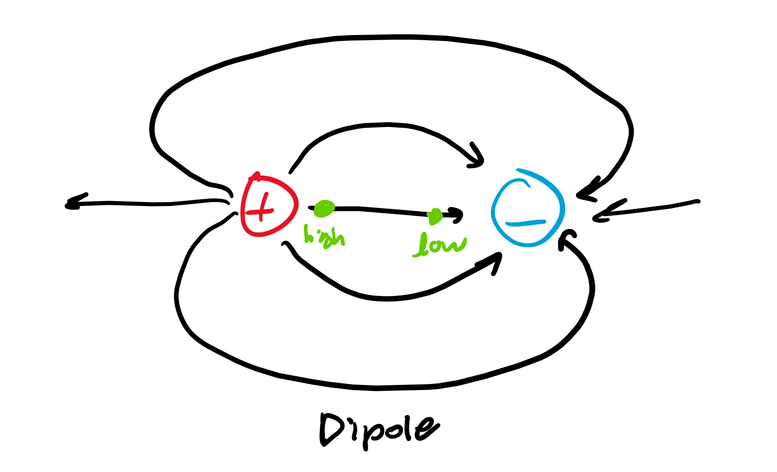
Drawing field lines
Emit from positive
Go into negative
High potential near positive charge
Low potential near negative charge

